Slide 1

Phoenix Brunch Store Analyze
For new business

Slide 2
Capstone Project — The Battle of Neighborhoods
Introduction
Phoenix is the capital city of Arizona and is in the central region of the state. People may know it for its year-round sun, desert beauty, and world-class resorts and golf, but as the fifth-largest city in the U.S., it also offers sophisticated urbans capes, southwest culture, and lots of outdoor adventure.
As the heart of Arizona, Phoenix having a huge amount of people working and living here. It is also the fifth-most populous city in the United States and the largest state capital by population, and the only state capital with a population of more than one million residents.
Also, lots of foreign visitors and immigrates come to live here. It has a mix of culture and people came come to multiple countries to live and open a restaurant right here. With its diverse cultures, comes diverse food items. There are many restaurants in Phoenix, each belonging to different categories like Japanese, Italian, French, etc.

Slide 3
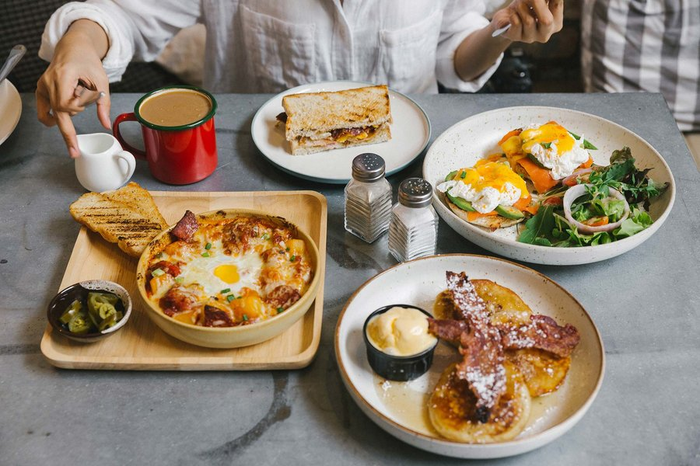
Questions to the business
What is the best location in Phoenix for Brunch?
What places have the best restaurants in Phoenix?
Which areas have a large/small number of Brunch Market?
Which is the best place to stay if I prefer Brunch?

Slide 4
Data & Approach
Phoenix Restaurants data that contains list Locality, Restaurant name, Rating along with their latitude and longitude.
Data source: yelp Kaggle dataset: "https://www.kaggle.com/yelp-dataset/yelp-dataset"
Description: This data set contains the required information. And we will use this data set to explore various locality of Phoenix.
Nearby places in each locality of Phoenix.
Data source: Foursquare API : "https://developer.foursquare.com/"
Description: By using this API we will get all the venues in each neighborhood.
Collect the Phoenix city data from yelp Kaggle dataset
Using Foursquare API we will find all venues for each neighborhood in Phoenix.
Filter out all brunch in Phoenix.
Using aggregative rating for each restaurant to find the best places.

Slide 5
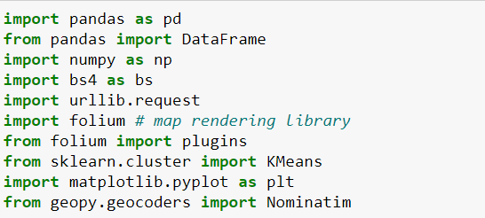
Packages
Foursquare API
Foursquare API is used to find all venues for each neighborhood and filter that are nearby by population density.
Also, the process will use aggregative rating for each restaurant to find the best places.
Visualize the Ranking of neighborhoods using folium library(python) to find the best place to open a new brunch

Slide 6
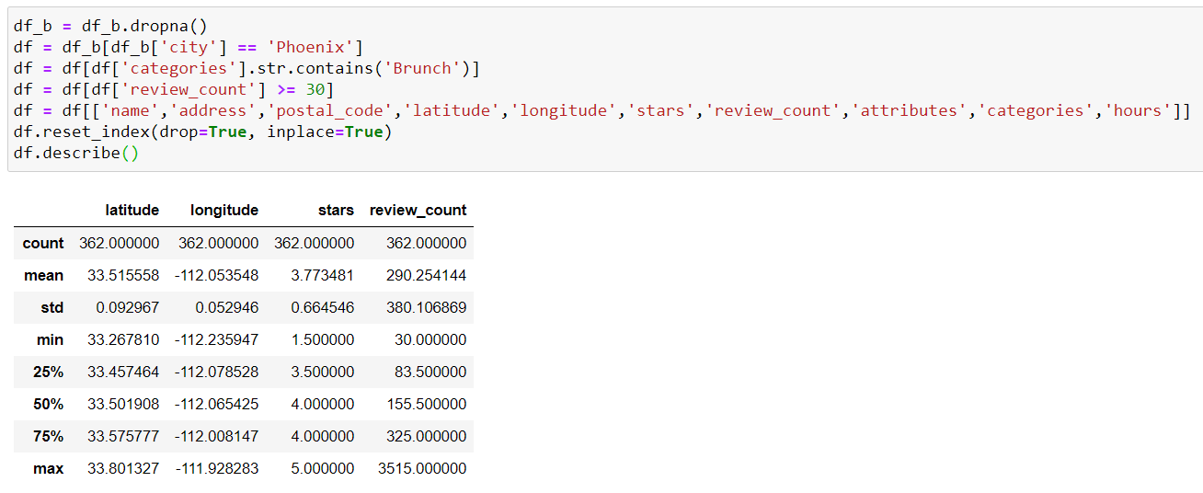
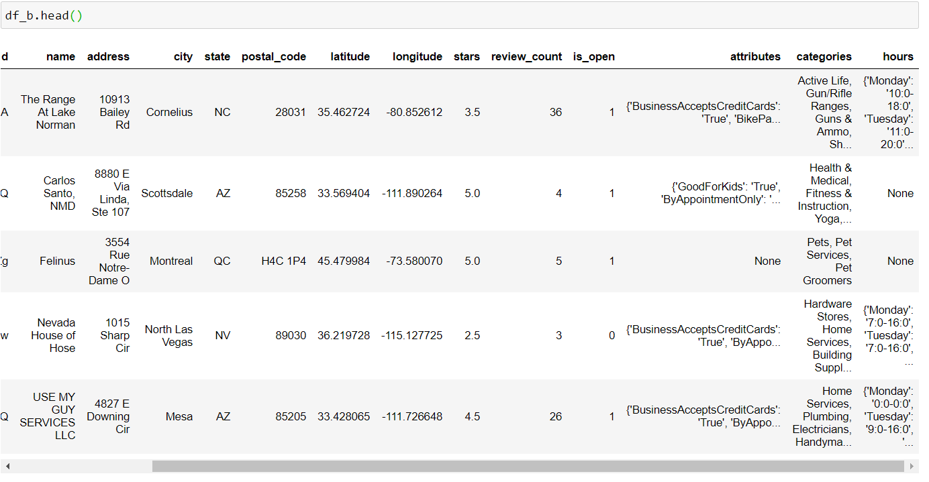
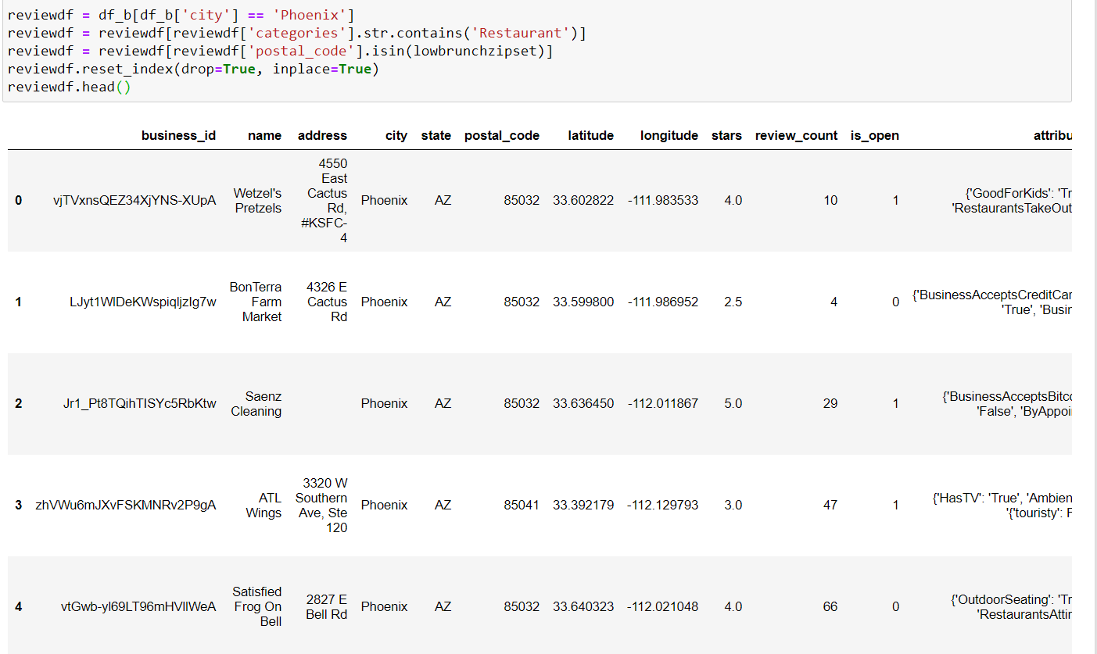
Raw data and cleaned data compare

Slide 7
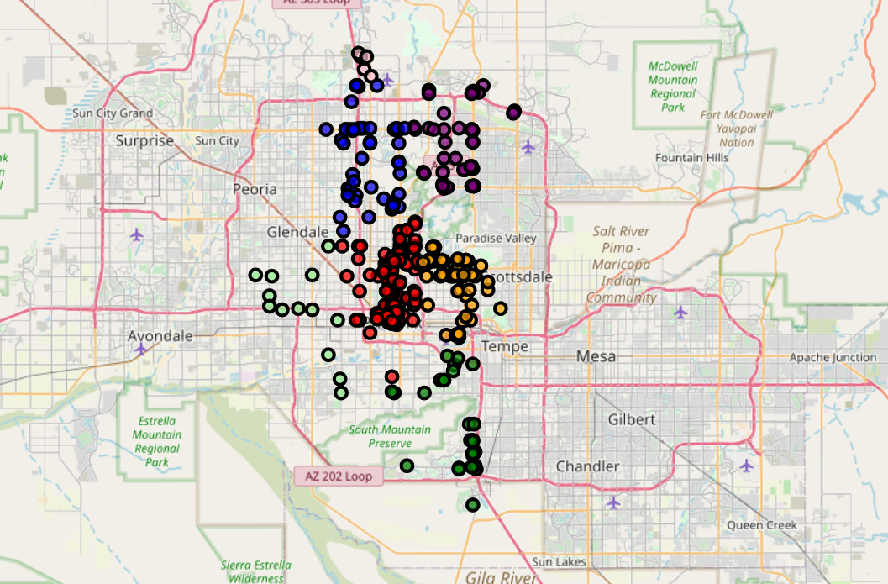
Brunch location cluster

Slide 8
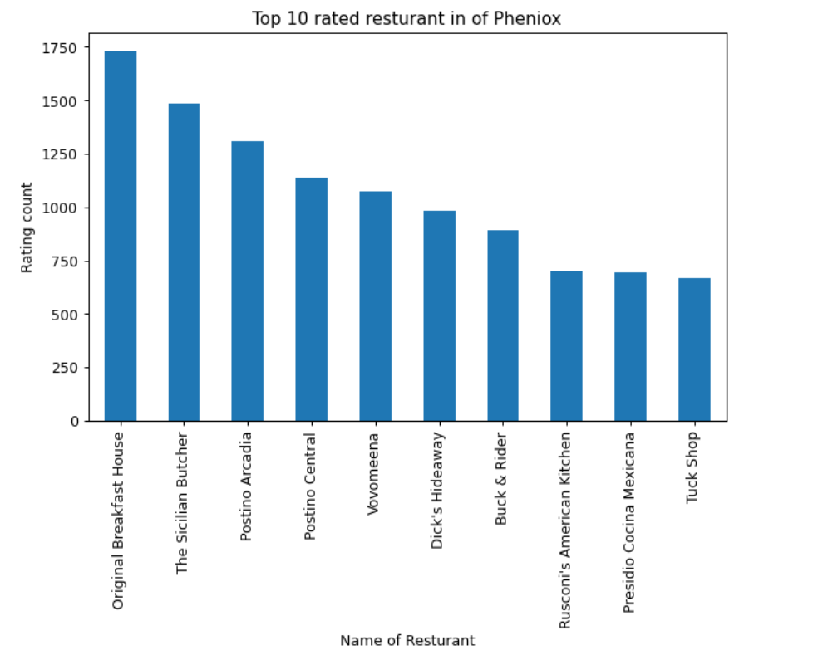
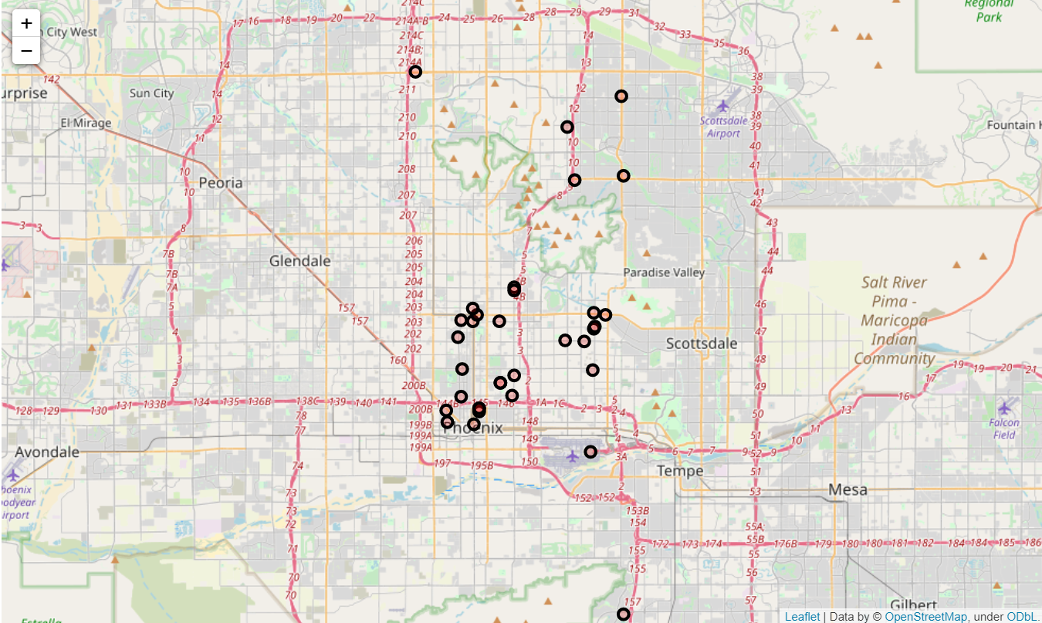
Best brunches

Slide 9
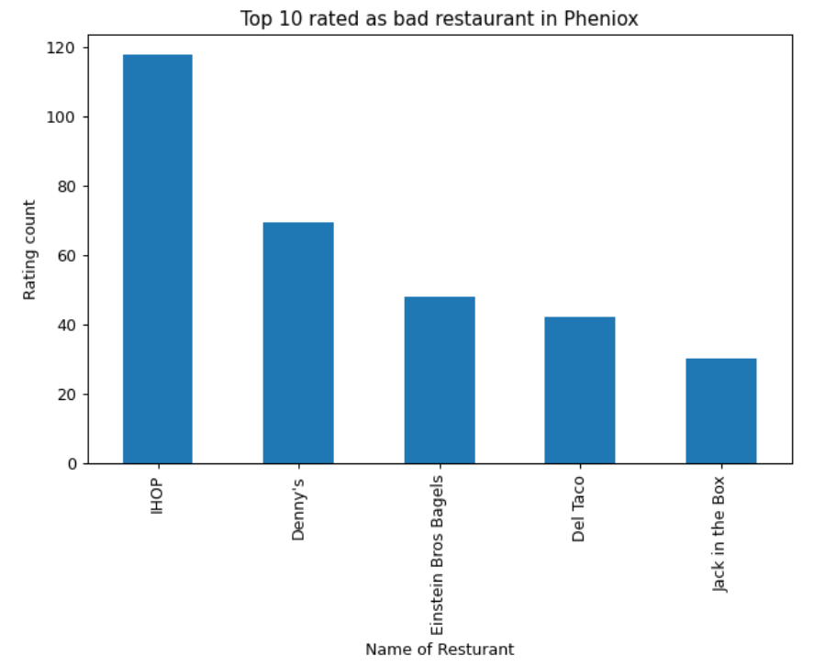
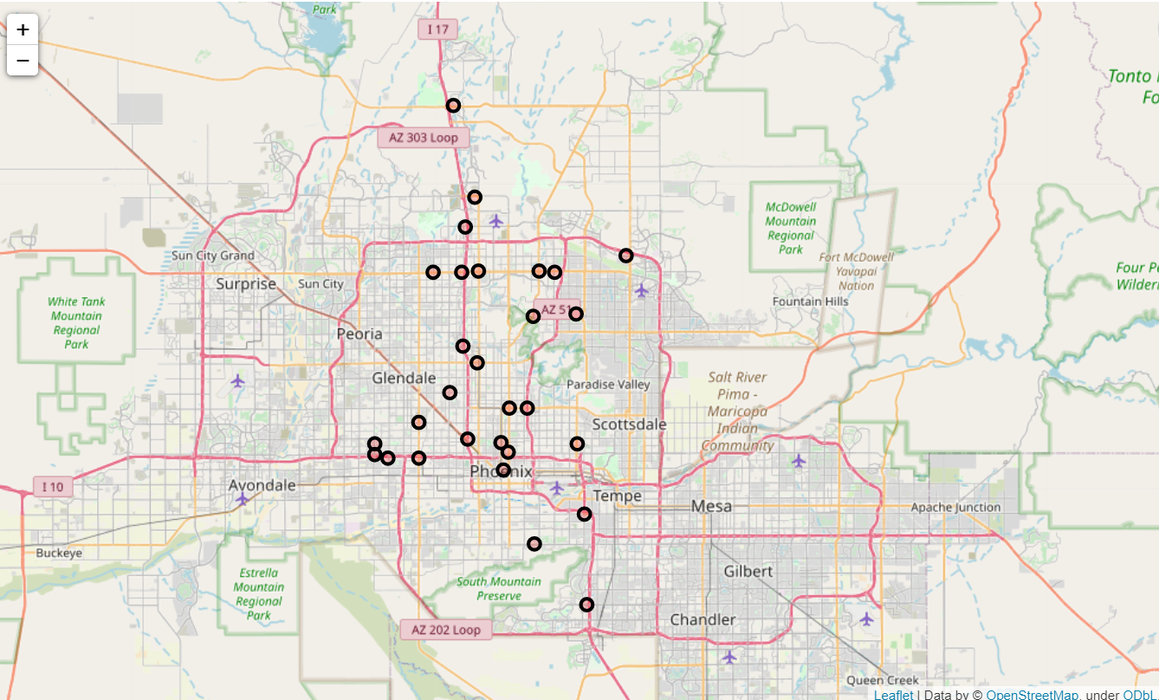
Worst brunches

Slide 10
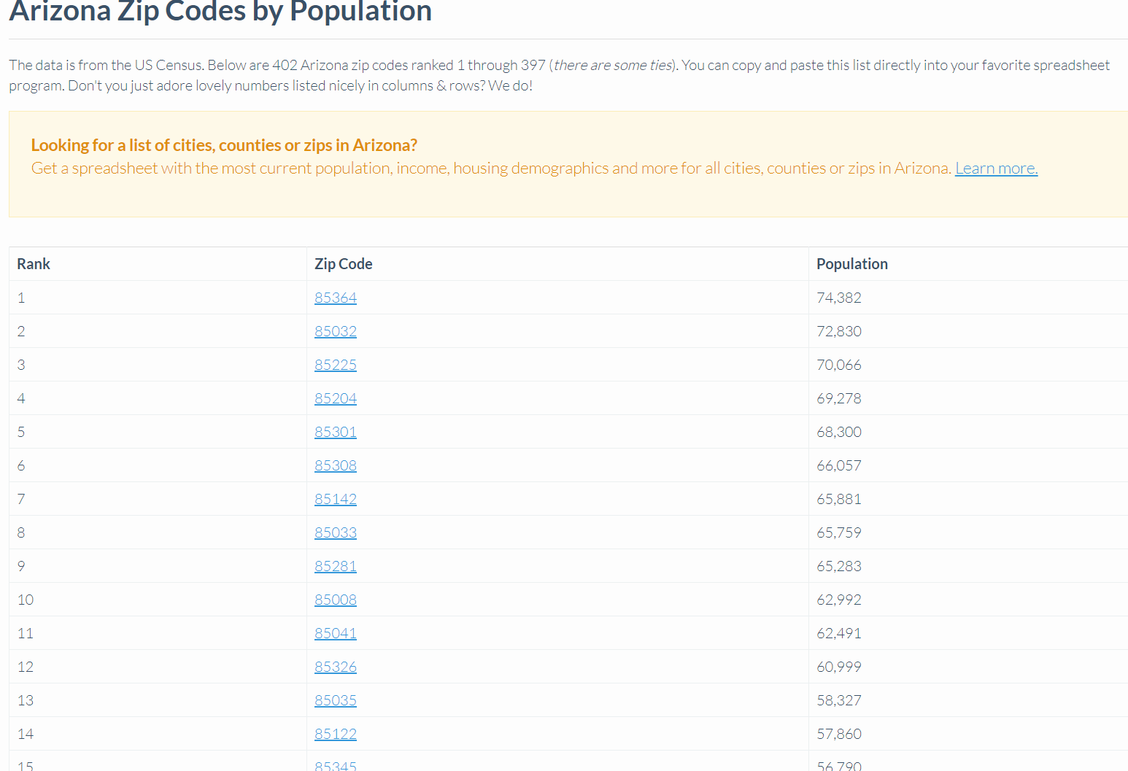
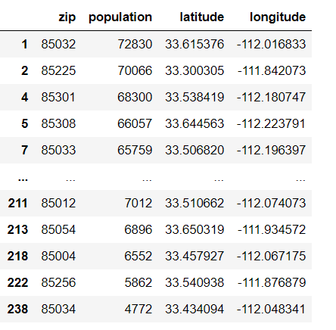
Population Density
source: https://www.arizona-demographics.com/zip_codes_by_population
Linked with Lat and Lon

Slide 11
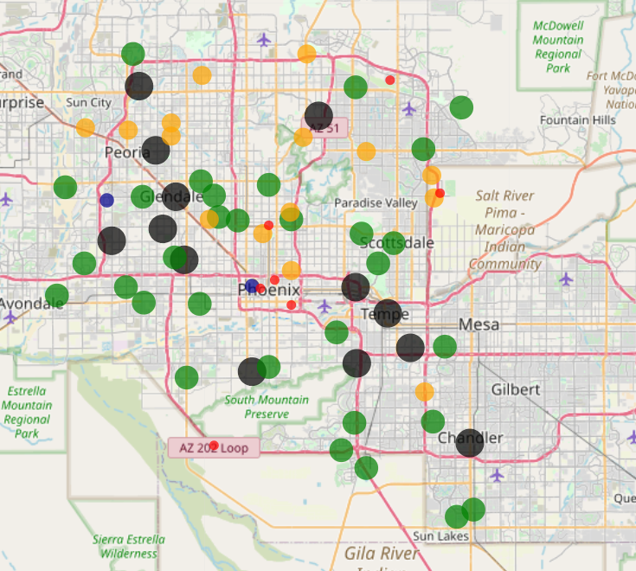
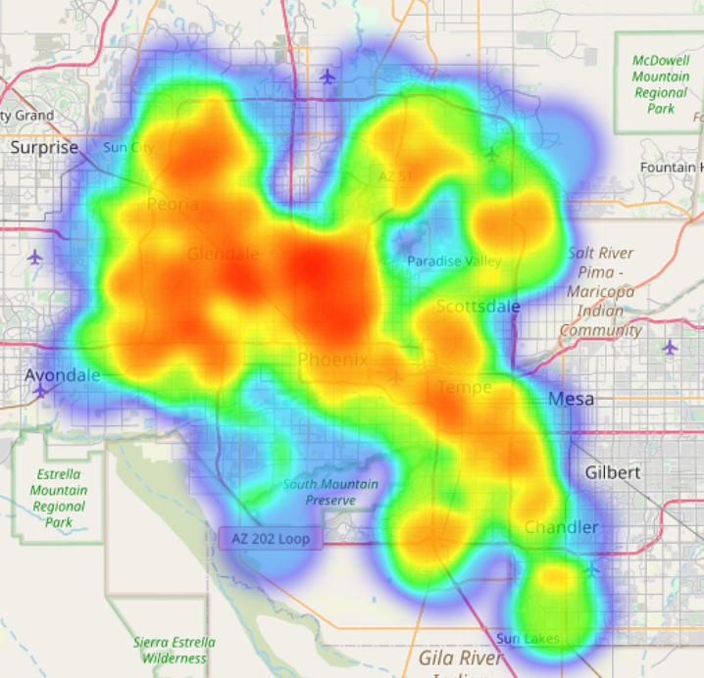
Population Density Result

Slide 12
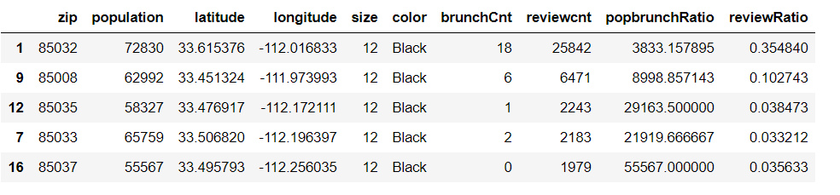
Calculate the review ratio

Slide 13
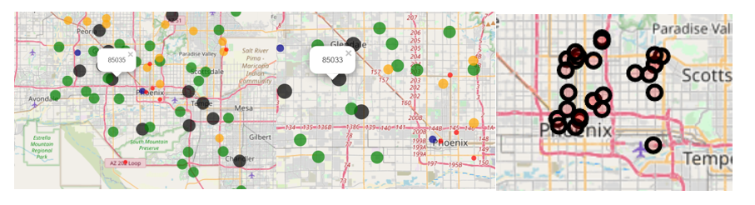
Conclusion
The top 5 place to a new brunch is ‘85032’, ’85008’, ‘85035’, 85033’, 85037’
zip code 85032 has the best review ratio and population, but it has a lot brunch already
85035 and 85033 are not good place since they locate near the best brunches
Compare with 85008 and 80537, 85008 has the best review ratio means a lot people nearby or work around love to eat in this place.

Slide 14
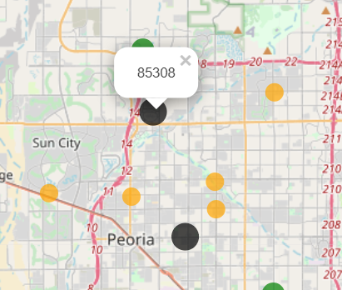
Final Conclusion
little competitors nearby
people nearby love to eat outside
although there is some brunch already, the big number of populations is still a good support for a new business. The ratio is almost 10,000: 1.

